Slide 1
CYBER SECURITY UPSKILLING PROGRAM قدم خلال مبادرة زنك/2 في جامعة البلقاء التطبيقية بالتعاون مع أكاديمية سايبر شيلد SEP 2024 Linux Part Version 1
INST.:ENG.ALI BANI BAKAR-0778642376(CYBER SHIELD ACADEMY)
DONE BY: ENG. Dana Al-Mahrouk-0798697842-BAU.UNIV.

Slide 2
Outline
Networks
Linux Essentials
Cybersecurity Foundation
Ethical Hacking
Digital Forensic Investigation

Slide 3
Day 7
Outline:
VMware & Ubuntu
Pwd
Ls
Touch
Mkdir
Cd
Path (relative & absolute)
Sudo
Adduser
Su
Telder (~)
$PATH

Slide 4

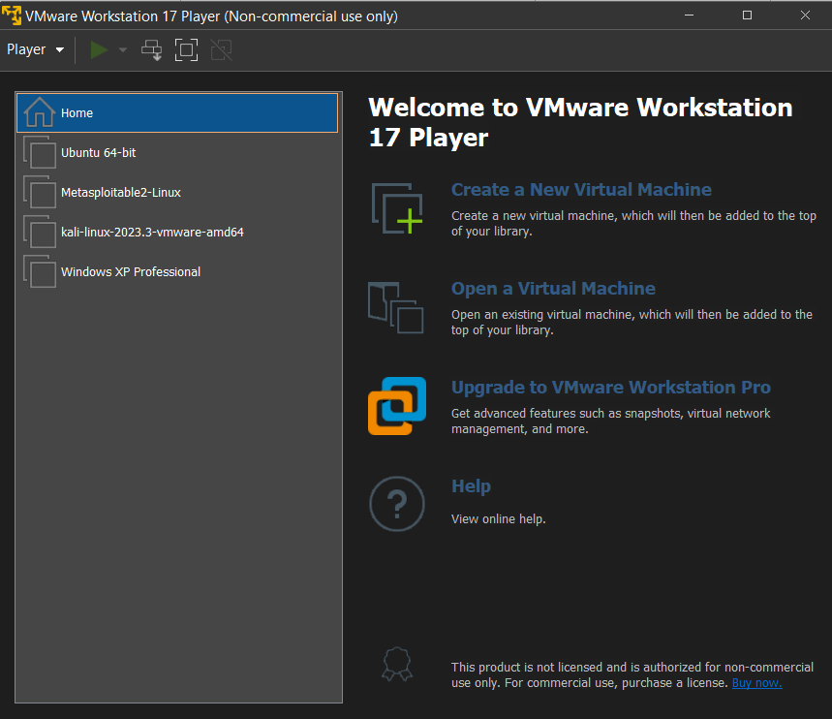
VMware
VMware specializes in providing software solutions that enable the creation and management of virtualized IT environments.

Slide 5

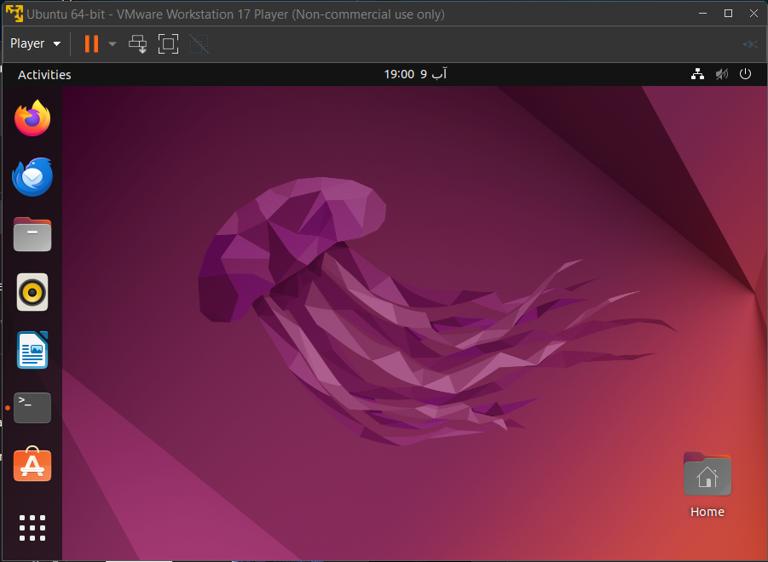
Ubuntu
Ubuntu is a popular open-source Linux distribution based on Debian and has gained widespread use due to its user-friendly interface, robust security features, and strong community support.

Slide 6
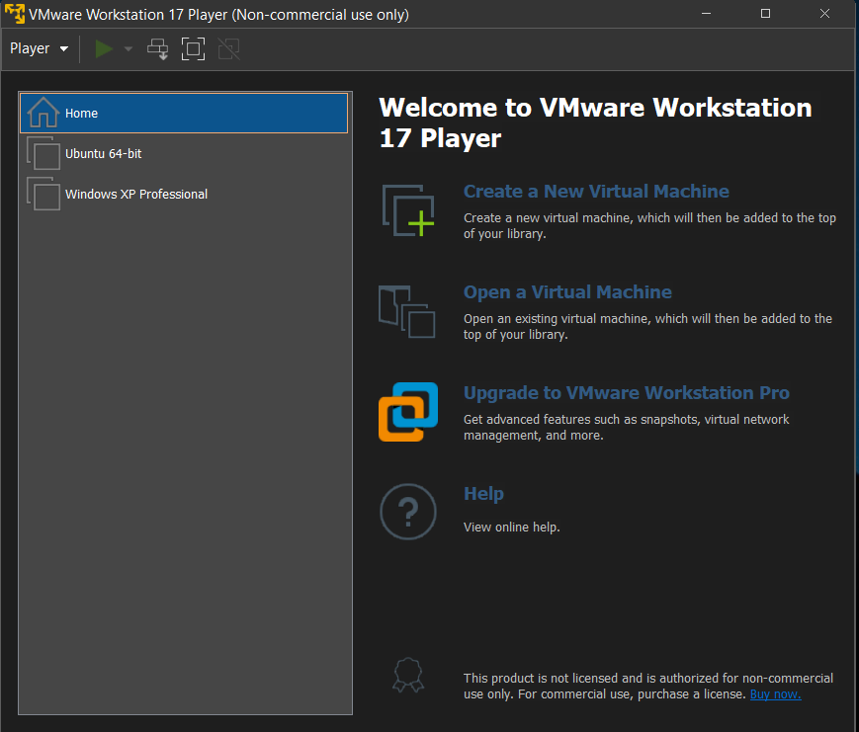
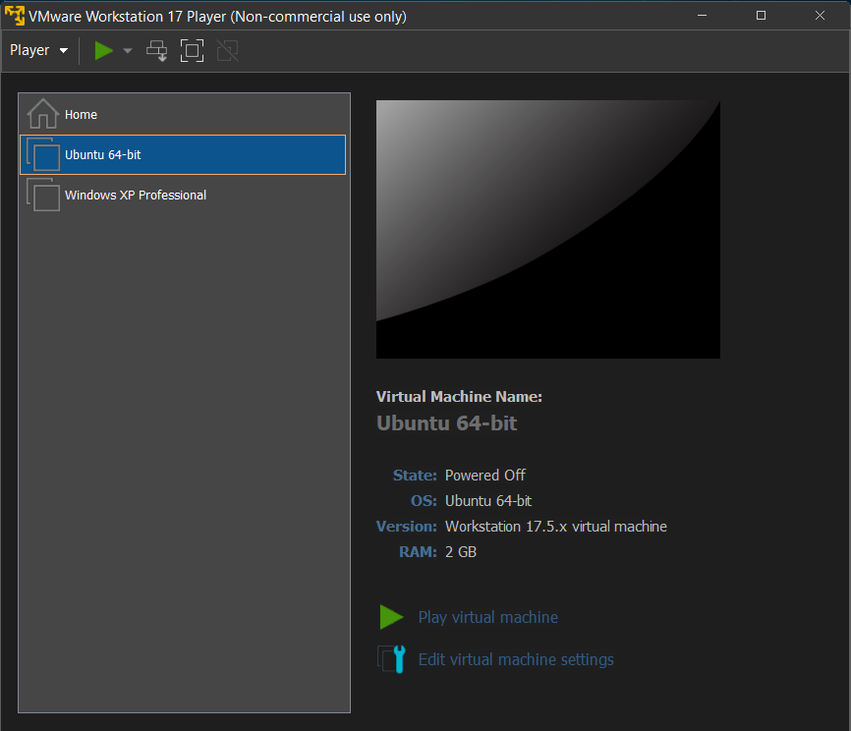

Slide 7
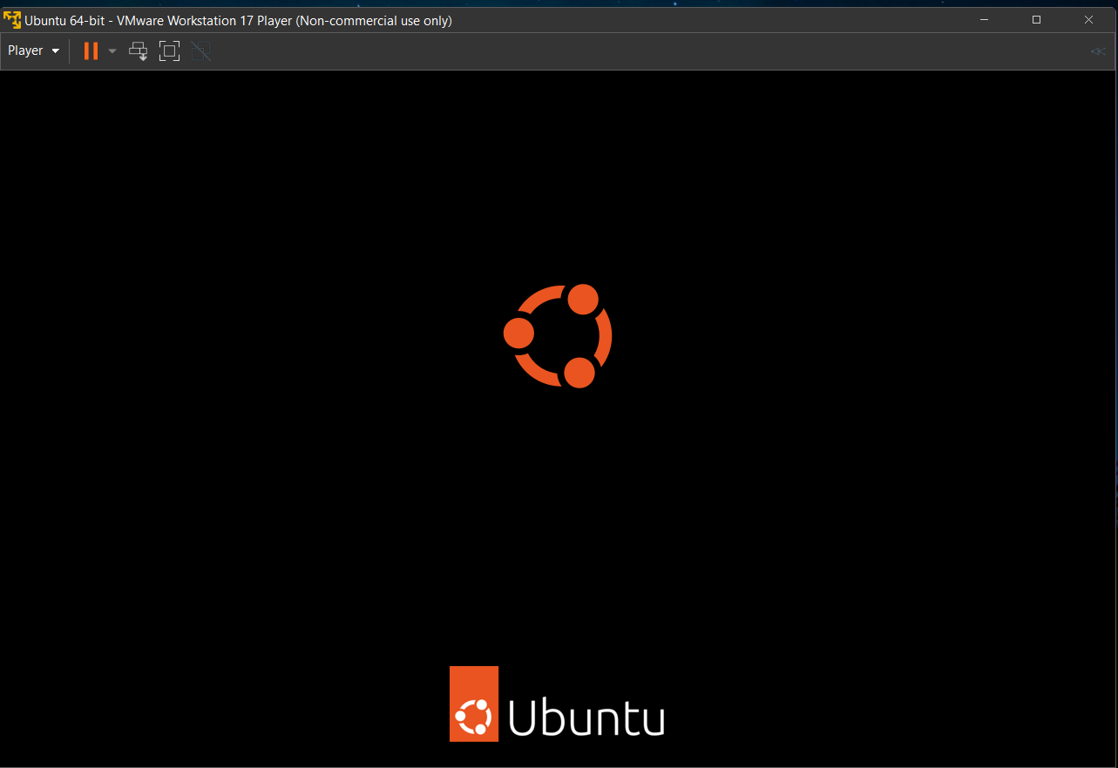
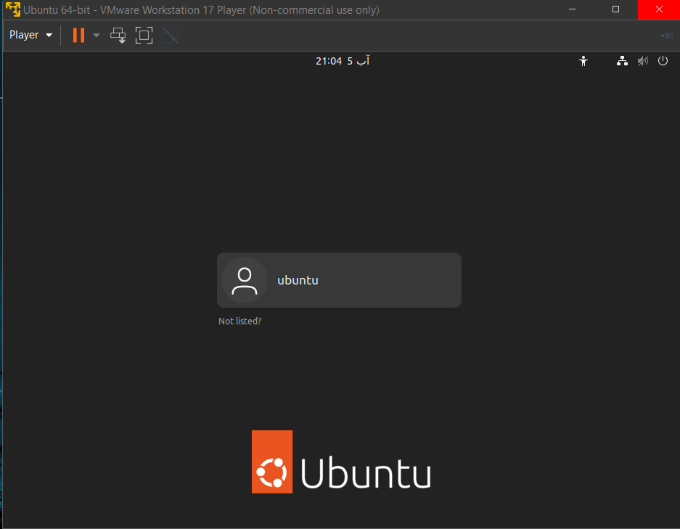

Slide 8
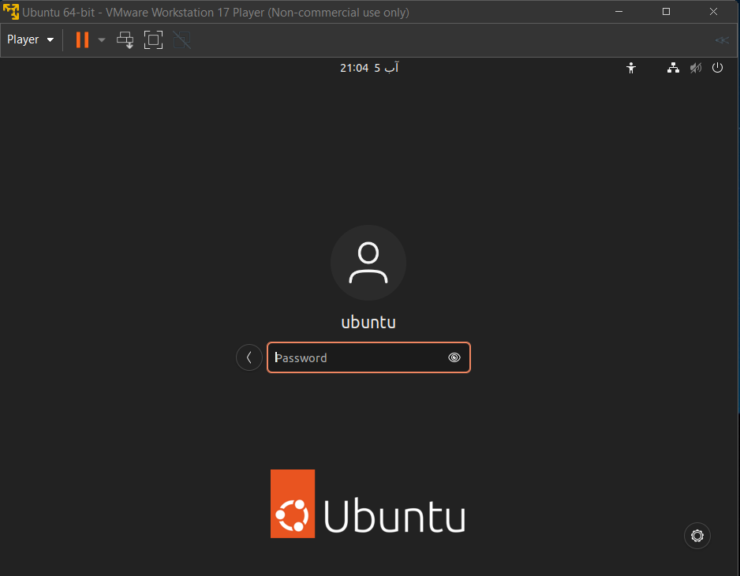


Slide 9
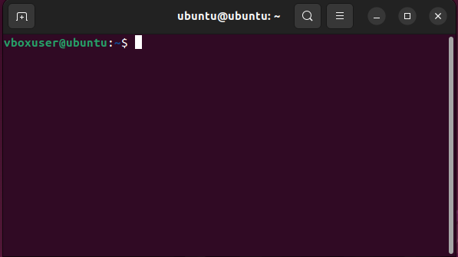
Terminal
is a text-based interface used to interact with your computer's operating system. Instead of using a graphical user interface (GUI) with windows, icons, and menus, you type commands into the terminal to perform tasks.
Type commands directly into the terminal to perform various tasks.
The terminal runs a command-line interpreter, or "shell," which processes the commands you enter.
Faster for performing repetitive tasks, as it allows for scripting and automation.
Gives you more control over the system

Slide 10
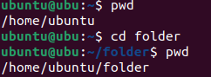
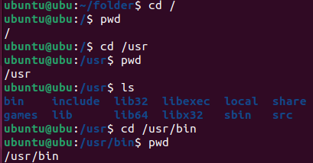
pwd (Print Working Directory)
It is used to display the path or location where you are now.

Slide 11
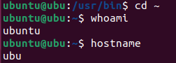
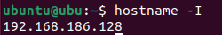
hostname
whoami
This command displays the username of the current user who is logged into the system.
- This command displays the name of the current machine or system you're working on.
- The hostname is typically set during the installation of the operating system and is used to identify the machine on a network.
- You can also set a new hostname using this command

Slide 12
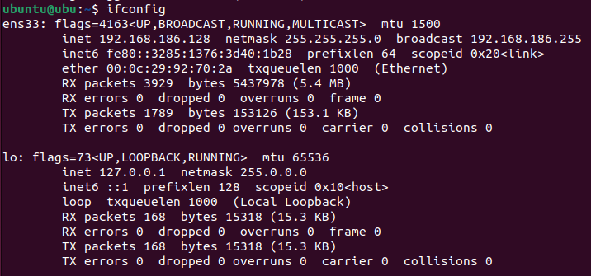
Ifconfig (old version)

Slide 13
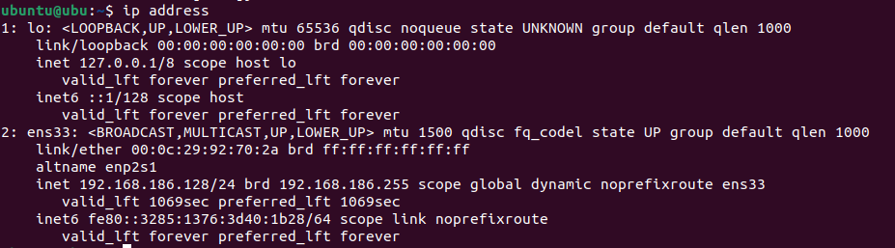
ip address (newer version)
iproute2 package
This command will list all network interfaces along with their IP addresses.
determine the IP address or addresses of your Linux system.

Slide 14
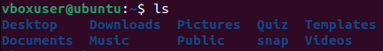
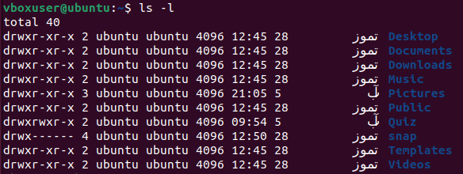
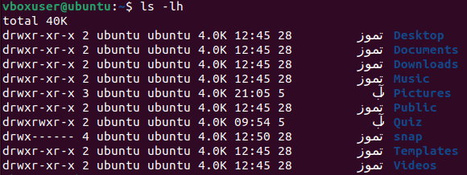
ls (List)
Lists the files and directories in the current directory.
-l ➔ detailed information
-h ➔ Human-Readable Sizes, KB, MB, GB, etc…
-a ➔ all files, including hidden files
-i ➔ inode number
-R ➔ list the current directory and all of its subdirectories.

Slide 15
Program
Program Name
Option
Option
Option
Option
Argument[0]
Arg [1]
Arg [2]
Arg [3]
Arg[4]

Slide 16
/usr/bin directory
/usr/bin: is a directory that contains executable programs, or binaries, which can be run from the command line.
When you run a program from `/usr/bin`, you can often specify options and arguments to control its behavior.

Slide 17
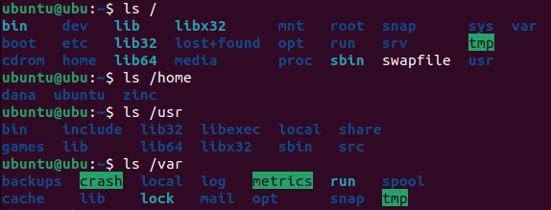
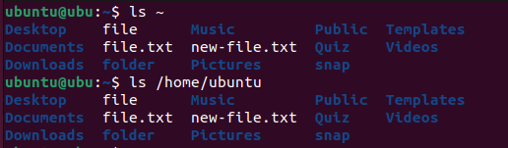
ls <path> ➔ Absolute

Slide 18
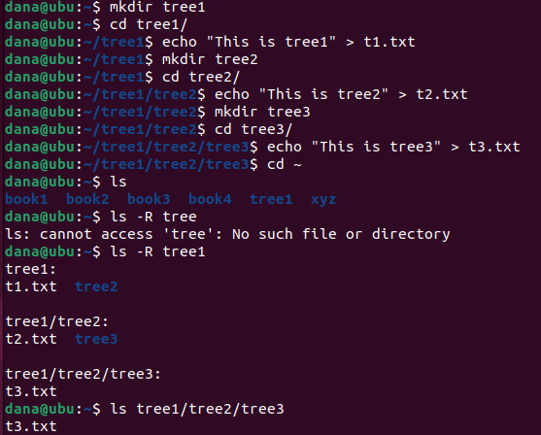
Ls <path> ➔ Relative

Slide 19
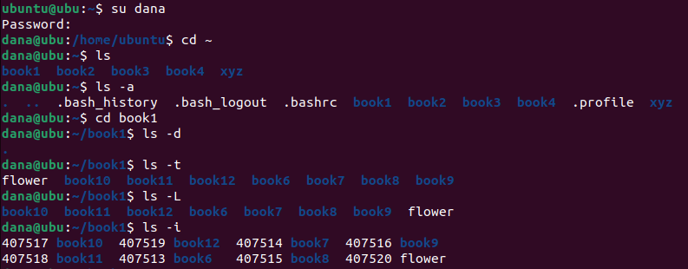
ls more options…

Slide 20

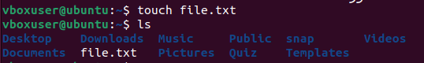
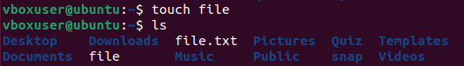
touch
Creates a new empty file or updates the timestamp of an existing file.
If `file.txt` already exists, `touch` will update its access and modification timestamps to the current time.
file extensions like `.txt` are primarily used as a convention to indicate the file type or content.
The extension is more for user convenience and does not dictate the file's behavior in Linux.
In Windows, file extensions are crucial as they are used by the operating system to determine which program should open the file.
For example, `.txt` files open with
Notepad by default.

Slide 21

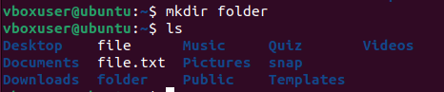
mkdir (Make Directory)
Creates a new directory.

Slide 22
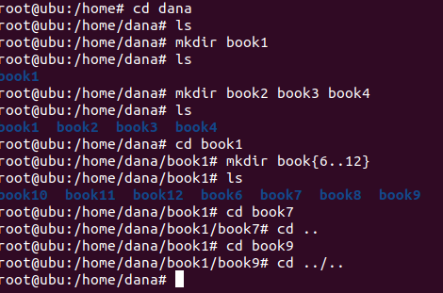
mkdir

Slide 23
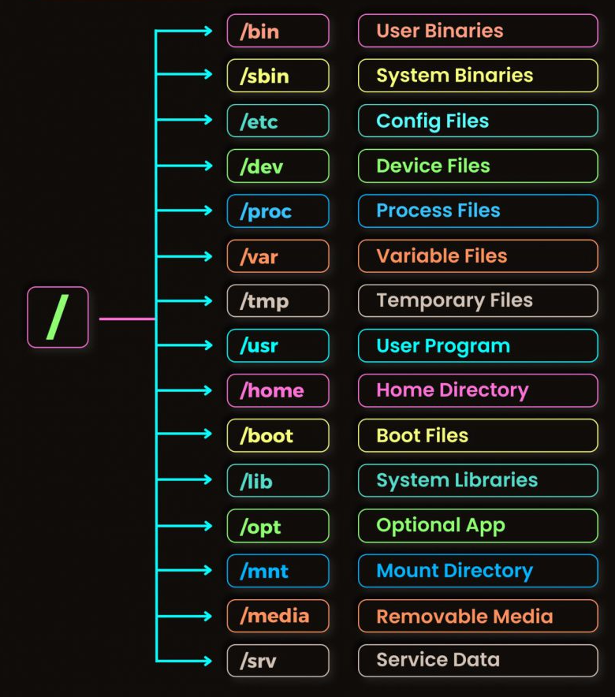
Path Relative & Absolute
Absolute Path: is a complete path that specifies the location of a file or directory from the root of the file system.
Ex: /home/user/documents/report.txt
`/` is the root directory.
Relative Path: specifies the location of a file or directory in relation to the current working directory. It does not start from the root but rather from the directory you are currently in.
Ex: documents/report.txt

Slide 24
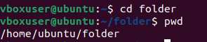
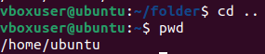
cd (Change Directory)
Changes the current directory to another directory.
The tilde (~):
is a Linux "shortcut" to denote a user's home directory.
For example, for user01, file /home/user01/test.
file can also be denoted by ~/test.

Slide 25
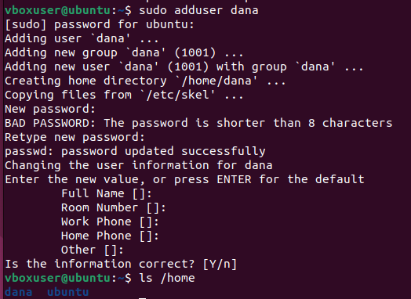
adduser
A command used to add a new user to the system.

Slide 26
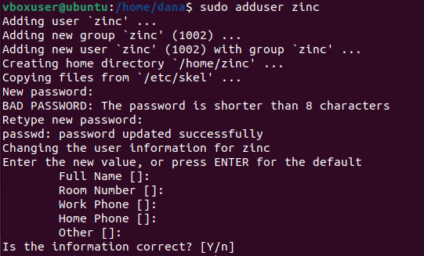

Slide 27
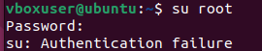
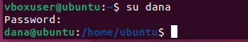
su (Substitute User)
Switches to another user account. Often used to switch to the root (administrator) account.

Slide 28
Day 8
Outline
Permission Deny
File Sudoers
/etc directory
/sudoers
/passwd
/shadow
$PATH
/usr directory
/bin
Type
Sudo
Cp
Echo [-e \n > >> 1> 2>]

Slide 29
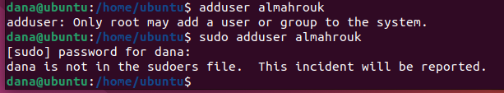
Permission
adduser: used to create new user accounts. Running `adduser` requires root privileges, meaning it should be executed with `sudo` if you're not logged in as the root user.
Regular users cannot create other users unless they have `sudo` privileges or root access.

Slide 30
Permission Denied
The "Permission Denied" error occurs when a user tries to perform an action that they don't have the necessary permissions for. This could involve reading, writing, or executing a file or directory, or running a command that requires elevated privileges.
Common Scenarios:
Trying to access a file that is owned by another user and not world-readable.
Attempting to run a command that requires root privileges without using `sudo`.
Modifying system files without appropriate permissions.

Slide 31
Sudoers File
located at `/etc/sudoers`, is used to control which users or groups could run commands as the root or another user via `sudo`.
It also allows fine-grained control over which commands can be run.
user ALL=(ALL:ALL) ALL
This allows `user` to run any command as any user on the system using `sudo`.
user ALL=(ALL) /usr/bin/apt-get
This allows `user` to run `apt-get` commands with `sudo`, but nothing else.

Slide 32
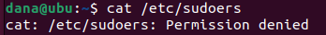
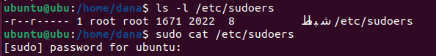
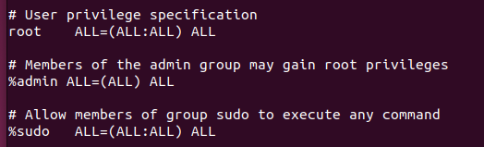
/etc/sudoers
is a configuration file that defines which users and groups have access to execute commands as the root user or another user. It also specifies the level of permissions granted and any specific conditions or restrictions on those permissions.

Slide 33
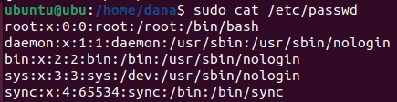
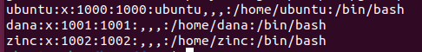
/etc/passwd
This file contains information about all the system's users.
Each line represents one user and contains seven fields:
username
password
(x indicates it is stored in `/etc/shadow`)
User ID
Group ID
user information (GECOS)
home directory ~
shell

Slide 34
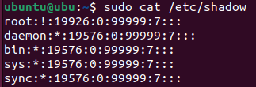
/etc/shadow
It contains the hashed passwords for all user accounts on the system, along with additional information related to password aging and account policies.

Slide 35
$PATH
An environment variable that specifies the directories in which the system looks for executable files.
shell searches through to find executable files when you type a command.
Setting `$PATH=0` is not a valid or meaningful operation and should be avoided. The `PATH` variable is essential for the functioning of your shell

Slide 36
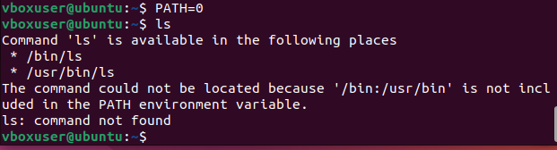
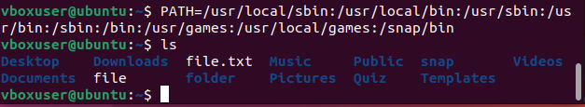
$PATH

Slide 37
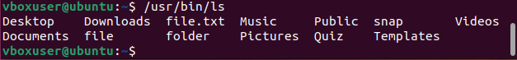
/usr/bin
The `/usr/bin` directory is where many user-level executables are stored on Unix and Linux systems.
Executables in `/usr/bin` are typically available to all users.
Running `/usr/bin/ls` specifically calls the `ls` command from this location, ensuring that you're using the standard version of `ls` that comes with your system, rather than a different version that might be located elsewhere in the `PATH`.

Slide 38
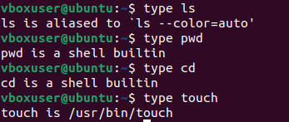
type
determine how a command will be interpreted by the shell. It tells you whether the command is a built-in shell command, an alias, a function, or an external executable.
`type ls` ➔ shows that `ls` is an external command located at `/usr/bin/ls`.
`type pwd` ➔ shows that `pwd` is a built-in command within the shell.

Slide 39
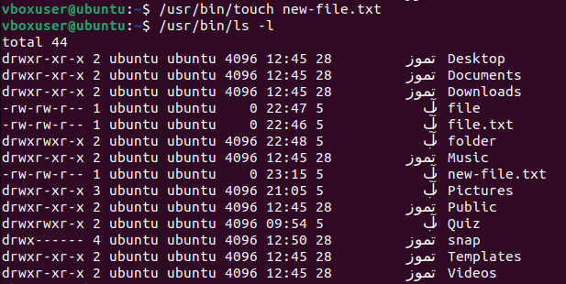
Ex2

Slide 40
sudo (Superuser Do)
Allows a permitted user to execute a command as the superuser or another user.
sudo apt update
sudo nano /etc/hosts
sudo yum install httpd

Slide 41
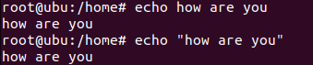
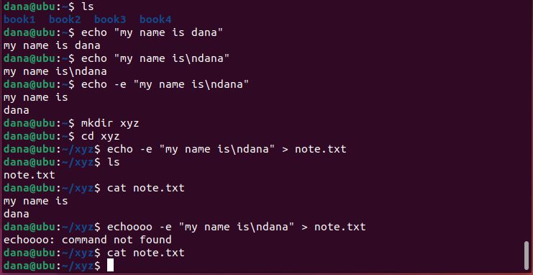
echo
display a line of text or a string to the terminal.
-e ➔ interpretation of backslash escapes
\n ➔ new line
-n ➔ prevents `echo` from adding a newline at the end of the output.

Slide 42
echo “…” > text.txt ➔ Overwrite
Writes the string “my name is\ndana" to `note.txt`, creating the file if it doesn't exist or overwriting it if it does.

Slide 43
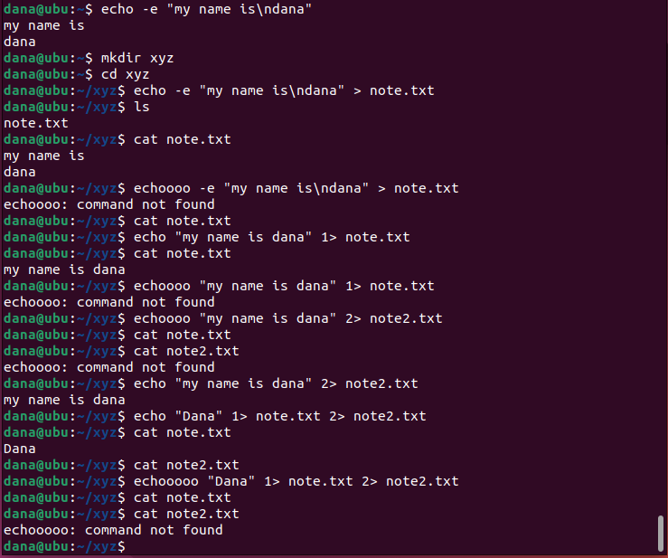
File 1 & 2
stdout
1
stdin
Bash
Standard Output (stdout): File descriptor `1`. This is the default output stream where commands send their regular output.
Standard Error (stderr): File descriptor `2`. This is the output stream where commands send their error messages.
1>: Redirects stdout to a file.
2>: Redirects stderr to a file.
stderr
2

Slide 44
Solution

Slide 45
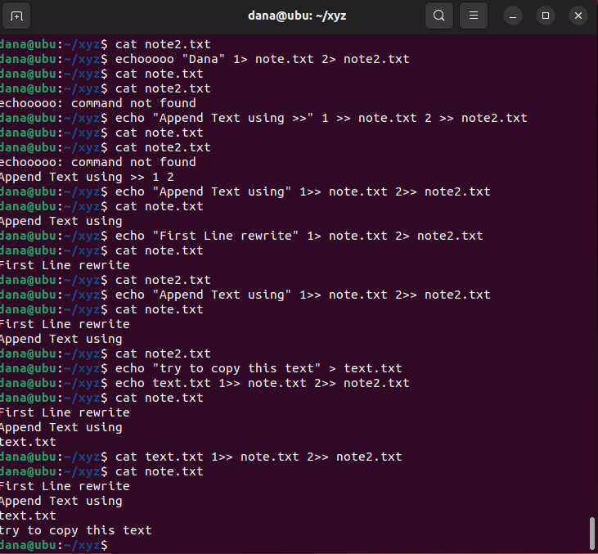
echo “…” >> text.txt ➔ Append
Appends "This is another line." to `file.txt` without overwriting the existing content.

Slide 46
Append File in File

Slide 47
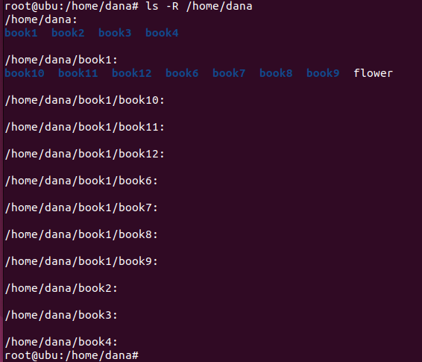
Ls -R

Slide 48

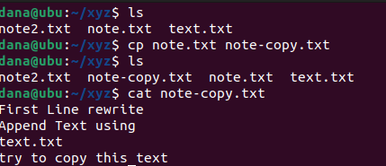
cp (Copy)
Copies files or directories from one location to another.

Slide 49


Slide 50

cp -i
`-i` (interactive): Prompts the user for confirmation before overwriting a file.
v

Slide 51

Copy multiple input to one directory
cp <…files|directory> <dest directory>

Slide 52


Package management
Update:
is used to refresh the package index. This means it updates the local list of available packages and their versions from the repositories configured on your system.
This command does not install or upgrade any packages. It simply ensures that your package manager has the most current information.
Upgrade:
is used to install the newest versions of all packages currently installed on the system, based on the updated package index.
This command will upgrade all packages that can be upgraded without removing any installed packages or installing new ones. If a package upgrade requires additional dependencies or package removal, it will not be done with this command.

Slide 53
Update
package index (local list)
Containers
repositories
package index (local list)
Package 1 ➔ A
Package 1 ➔ A
Package 1 ➔ A
Package 2 ➔ B
Package 2 ➔ B
Package 2 ➔ B
Package 3 ➔ C
Package 3 ➔ C
Package 3 ➔ C
Package 4 ➔ D
Package 4 ➔ D
Package 4 ➔ D
Package 5 ➔ E
Package 5 ➔ E
Package 6 ➔ F
Package 6 ➔ F
Before Update
After Update

Slide 54
Upgrade
package index (local list)
Containers
repositories
package index (local list)
Package 1 ➔ A
Package 1 ➔ A
Package 1 ➔ A
Package 2 ➔ B
Package 2 ➔ B
Package 2 ➔ B
Package 3 ➔ C
Package 3 ➔ C
Package 3 ➔ C
Package 4 ➔ D
Package 4 ➔ D
Package 4 ➔ D
Package 5 ➔ E
Package 6 ➔ F
Before Upgrade
After Upgrade

Slide 55
Account
Service-Level:
services run under specific user accounts with particular permissions. These permissions define what the service can and cannot do on the system.
Least Privilege: services run with the least privilege necessary to perform their function.
Exploiting a Service: If a hacker exploits a vulnerability in a service, they typically inherit the permissions of the user under which that service is running.
User-Level:
Logged-In User: If a service is compromised, the hacker does not automatically gain the permissions of any other users who are logged in. They are restricted to the permissions of the service itself.
Privilege Escalation: After gaining initial access, hackers may attempt to escalate their privileges to gain broader access. This could involve exploiting other vulnerabilities to move from the permissions of a low-privileged service to a higher-privileged user, like `root`.

Slide 56
/etc/passwd
This file contains information about all the system's users.
Each line represents one user and contains seven fields:
username
password
(x indicates it is stored in `/etc/shadow`)
User ID
Group ID
user information (GECOS)
home directory ~
shell
- When a new user is created, both a User ID (UID) and a Group ID (GID) are generated.
- The user is assigned a primary group, usually with the same name and ID as the user,

Slide 57

File permission
File permissions in Linux control who can read, write, or execute a file. Understanding these permissions is key to managing access to files and directories.
Everything is a file
Permission type:
Read
Write
Execute
Allow
Deny
 | File | Directory
Read | Read Cat | nano | vim | List contents
Write | Modify Cut | past | edit | altering the contents Create | Remove
Execute | running as a program Script | enter it Cd

Slide 58
Permission Groups
1. Owner (User): The user who owns the file.
2. Group: Other users who are in the same group as the file.
3. Others: All other users.

Slide 59


Slide 60

chmod
Other Permission
Can Read
Can not Write
Other Permission
Can Write
Can Read

Slide 61

chmod ➔ change mode

Slide 62

Example

Slide 63


Slide 64


Slide 65


Slide 66


Slide 67


By default, when creating a file it is:
User & Group ➔ read & write
Q: Why execute is not?
Most files created by users are text files, scripts, or data files.
If every file were executable by default, it could lead to accidental or malicious execution of files that shouldn't be run as programs.
Other ➔ read only
/etc/passwd
/etc/shadow
The `/etc/shadow` file is highly sensitive because it stores hashed passwords. Therefore, only the `root` user is allowed to read this file

Slide 68

/etc/shadow
Even though the passwords are hashed, it's crucial to protect this file from unauthorized access to prevent offline attacks, such as brute force or dictionary attacks on the hashed passwords.
Notice that the beginning of the hash value is the same for all three users because it is the same password, so why don't they have the same full hash value? The reason is that a random value is added to the password to make it more difficult to discover

Slide 69

Login to Root User
normal users do not have the ability to execute administrator commands or access the root account directly. Instead, when they attempt to perform actions that require elevated privileges, the system prompts for a password or logs the attempt if it fails.
if a user tries to use `sudo` without permission, they will see a message like `user is not in the sudoers file. This incident will be reported.`
1
2

Slide 70

`sudo`: the system checks whether the user is allowed to perform this action by consulting the `/etc/sudoers` file. If allowed, the system will prompt the user for their own password (not the root password) to verify their identity.
`su`: the system will ask for the root password. If the user doesn’t know the root password, the attempt will fail.
1
2
3
4
5

Slide 71

Logging of Failed Login Attempts: ➔ `/var/log` directory
`/var/log/auth.log`: On Debian-based systems (like Ubuntu), authentication logs, including `sudo` attempts and `su` attempts, are recorded here.
`/var/log/secure`: On Red Hat-based systems (like CentOS and Fedora), the corresponding log file is `/var/log/secure`.
Contents: These log files record details such as the date and time of the attempt, the user who attempted the action, the command they tried to execute, and whether the attempt was successful.

Slide 72




/etc/passwd ➔ /bin/bash-python3

Slide 73


Permission of Files

Slide 74
Day 9
Outline
Review chmod
Process
Intro
PID, PPID, State
Fork → bash
Kill → exit
Echo $$
Firefox, sleep
Ctrl + C
Ctrl + Z
Jobs
Fg %<…>
&

Slide 75
Day 9
Outline
Process Cont…
ps
Ps –a
Ps –aux
Ps –aux | more
Pstree
Gnom
Ctrl + Shift + f4

Slide 76
Day 9
Outline
Cp
rm
Ls –la
Cat
More
Less
Grep
Grep –i
Grep \|
Grep –r

Slide 77
Process
A process is an instance of a running program. When you execute a command or run an application, the operating system creates a process to handle it. Each process has a unique Process ID (PID) and is managed by the Linux kernel.
Hard disk
RAM
Book.txt
P1 (Book.txt)
Flower.jpg
Calc.exe
java
P2 (java)
bash
P3 (bash)
Firefox
P4 (Firefox)
Run - Open

Slide 78
Child Process
A child process in Linux is a process created by another process, referred to as the parent process.
The child process inherits the parent's memory space, including code, data, and file descriptors. However, the child process has its own PID and separate memory space, allowing it to execute independently.
Parent of
P1 ➔ X
PID = 10
Parent of
P2 ➔ Y
PID = 16
PPID = 10
P3 ➔ Z
child of
PID = 23
PPID = 16
child of

Slide 79
Fork
The `fork()` system call is used to create a new process by duplicating the calling process. This is fundamental in Linux for process management.
fork
Parent of
P1 ➔ bash
fork
PID = 7
Parent of
P2 ➔ Y
PID = 9
PPID = 7
P3 ➔ Z
child of
PID = 16
PPID = 9
child of

Slide 80
Kill
send signals to processes, often to terminate them.
`kill -9`: This sends the `SIGKILL` signal, which forcefully and immediately kills the process without giving it a chance to clean up.
`kill -15`: This sends the `SIGTERM` signal, which politely asks the process to terminate. The process can catch this signal and clean up resources before exiting.
`kill -2`: This sends the `SIGINT` signal, which is like pressing `Ctrl+C` in the terminal.

Slide 81
Ctrl + C on Child process
The `Ctrl + C` sends a `SIGINT` (Signal Interrupt) signal to the foreground process group in a terminal.
Sends `SIGINT` to the child if it’s in the foreground. The child usually terminates, with control returning to the parent.
P1 ➔ bash
P1 ➔ bash
PID = 7
PID = 7
P2 ➔ Y
P2 ➔ Y
Kill
PID = 9
PPID = 7
PID = 9
PPID = 7
P3 ➔ Z
PID = 16
PPID = 9

Slide 82
Ctrl + C on Parent process
Sends `SIGINT` to the parent. If the parent is in the foreground, it typically terminates, potentially also affecting child processes based on how the parent is coded.
P1 ➔ bash
P1 ➔ bash
Kill
PID = 7
PID = 7
P2 ➔ Y
PID = 9
PPID = 7
P3 ➔ Z
PID = 16
PPID = 9

Slide 83

Ex
echo $$ → prints the Process ID (PID) of the current shell session to the terminal.
bash → in a terminal starts a new Bash shell session, nested within the current one.
exit or Ctrl + D → exit the new Bash shell by typing, which returns you to the parent shell.
bash
P1 ➔ bash
PID = 2612
bash
P2 ➔ bash
PID = 2732
PPID = 2612
P3 ➔ bash
PID = 2748
PPID = 2732

Slide 84
bash
P1 ➔ bash
PID = 2612
P2 ➔ bash
PID = 2732
PPID = 2612
Kill
P3 ➔ bash
PID = 2748
PPID = 2732
bash
P1 ➔ bash
P1 ➔ bash
PID = 2612
PID = 2612
bash
P2 ➔ bash
P2 ➔ bash
PID = 2732
PPID = 2612
PID = 2732
PPID = 2612
P3 ➔ bash
PID = 2849
PPID = 2732

Slide 85

ps
The `ps` command in Linux is used to display information about the currently running processes on the system.
It provides a snapshot of the processes running at the time the command is executed.
including details like process IDs, user IDs, CPU usage, memory usage, and more.

Slide 86
ps
`ps -e` or `ps -A`: Lists all processes running on the system.
`ps -f`: Provides a full-format listing, showing more details about each process.
`ps -ef`: Another option for a full-format listing, showing processes in a standard Unix format.
`ps -l`: Provides a long format listing, including additional information like priority and nice value.
`ps -ejH`: Displays the process hierarchy in a tree format, showing parent-child relationships.
`ps -axjf`: Another way to view the process tree, including more details.
`ps -aux`: Displays all processes with detailed information, including
processes from all users (`a`)
processes not attached to a terminal (`x`)
user-oriented format (`u`)

Slide 87
PID: Process ID.
TTY: Terminal associated with the process.
TIME: CPU time consumed by the process.
CMD: Command that started the process.
C: CPU utilization of the process.
STIME: Start time of the process.

Slide 88

firefox
launch the Firefox web browser from the terminal.
Open a Specific URL: firefox https://www.facebook.com
Run Firefox in the Background: firefox &
Private Browsing Mode: firefox --private-window
Open Firefox with a Specific Profile: firefox -P "ProfileName"
Safe Mode: firefox --safe-mode

Slide 89


Slide 90

Ctrl + C
The `Ctrl + C` sends a `SIGINT` (Signal Interrupt) signal to the foreground process group in a terminal.

Slide 91
Foreground & Background
Foreground Processes
runs directly in the terminal and takes control of the terminal until it completes. the terminal is tied up with that process, and you cannot use it for other commands until the process finishes or is interrupted
- You can interact with the process.
Background Processes
runs independently of the terminal. the terminal remains free for you to execute other commands. useful for tasks that do not require user interaction and may take a long time to complete.
You can view and manage background processes using commands like `jobs`, `fg`, `bg`, and `kill`.

Slide 92
Managing Background Processes
`jobs`: Lists all background jobs associated with the current terminal.
`fg`: Brings a background process to the foreground. If you have multiple background jobs, you can specify which one by its job number.
`bg`: Resumes a paused job in the background. If a job is stopped (e.g., after pressing `Ctrl + Z`), you can use `bg` to continue it in the background.
`kill`: Sends a signal to terminate a background process (or any process) by its PID or job number.

Slide 93
Process state
Running (R): The process is either executing instructions on the CPU or waiting in the run queue to be scheduled.
Sleeping: The process is waiting for an event (like I/O) to complete
Interruptible Sleep (S)
Uninterruptible Sleep (D)
Stopped (T): using `SIGSTOP`, `SIGTSTP`, `SIGTTIN`, or `SIGTTOU` signal, A stopped process can be resumed by sending it a `SIGCONT` signal or `Ctrl + Z`.
Zombie (Z): The process has completed execution, but still has an entry in the process table.
Idle (I): The process is waiting for an event to occur and is not actively using CPU resources.
Dead (X): The process has finished execution and has been removed from the process table.

Slide 94


Ctrl + Z → Stopped process

Slide 95

Firefox Child Processes
Socket Process: This process handles network communication and is responsible for managing sockets. It helps in managing the data transfer between the browser and web servers.
WebExtensions: These are extensions or add-ons that enhance the functionality of the browser. do not interfere with the main browser operations.
Privileged Content: This process deals with content that requires special permissions or access
Utility Process: for tasks that don’t fit into the other categories, such as handling certain types of data or performing specific functions needed by the browser.
Web Content: These processes are responsible for rendering web pages and handling the content displayed in the browser.

Slide 96
Process State
Hard disk
RAM
Foreground
Run
Firefox
P1 (Firefox)
Kill
Ctrl + C
Ctrl + Z
bg %...
Background
fg %...
Running
Stopped
&

Slide 97
Socket Process
manages the creation, maintenance, and closure of network connections.
This isolation helps in ensuring that network-related issues or vulnerabilities don’t affect other parts of the browser.
If there’s an issue with the network communication or an attempted attack, it is less likely to impact the entire browser or user data.

Slide 98

Ps -aux
to display a snapshot of the current processes running on the system.
-a: about all users' processes except session leaders.
-u: detailed information about each process, including the user who owns the process.
-x: Shows processes that are not running on a terminal (not connected to a TTY).

Slide 99

Ps –aux | more

Slide 100


Slide 101

Notes:
ubuntu@ubu:~$ pstree
systemd─┬─ModemManager───2*[{ModemManager}]
├─NetworkManager───2*[{NetworkManager}]
├─VGAuthService
├─accounts-daemon───2*[{accounts-daemon}]
├─acpid
├─avahi-daemon───avahi-daemon
├─colord───2*[{colord}]
├─cron
├─cups-browsed───2*[{cups-browsed}]
├─cupsd
├─dbus-daemon
├─gdm3─┬─gdm-session-wor─┬─gdm-wayland-ses─┬─gnome-session-b───2*[{gnome-session-b}]
│ │ │ └─2*[{gdm-wayland-ses}]
│ │ └─2*[{gdm-session-wor}]
│ └─2*[{gdm3}]
├─gnome-keyring-d───3*[{gnome-keyring-d}]
├─irqbalance───{irqbalance}
├─2*[kerneloops]
├─networkd-dispat
├─packagekitd───2*[{packagekitd}]
├─polkitd───2*[{polkitd}]
├─power-profiles-───2*[{power-profiles-}]
├─rsyslogd───3*[{rsyslogd}]
├─rtkit-daemon───2*[{rtkit-daemon}]
├─snapd───9*[{snapd}]
├─switcheroo-cont───2*[{switcheroo-cont}]
├─systemd─┬─(sd-pam)
│ ├─at-spi2-registr───2*[{at-spi2-registr}]
│ ├─dbus-daemon
│ ├─dconf-service───2*[{dconf-service}]
│ ├─evolution-addre───5*[{evolution-addre}]
│ ├─evolution-calen───8*[{evolution-calen}]
│ ├─evolution-sourc───3*[{evolution-sourc}]
│ ├─2*[gjs───4*[{gjs}]]
│ ├─gnome-session-b─┬─at-spi-bus-laun─┬─dbus-daemon
│ │ │ └─3*[{at-spi-bus-laun}]
│ │ ├─evolution-alarm───5*[{evolution-alarm}]
│ │ ├─gsd-disk-utilit───2*[{gsd-disk-utilit}]
│ │ ├─update-notifier───3*[{update-notifier}]
│ │ └─3*[{gnome-session-b}]
│ ├─gnome-session-c───{gnome-session-c}
│ ├─gnome-shell─┬─Xwayland
│ │ ├─gjs───5*[{gjs}]
│ │ ├─gnome-control-c───6*[{gnome-control-c}]
│ │ └─8*[{gnome-shell}]
│ ├─gnome-shell-cal───5*[{gnome-shell-cal}]
│ ├─gnome-terminal-─┬─bash───pstree
│ │ └─3*[{gnome-terminal-}]
│ ├─goa-daemon───3*[{goa-daemon}]
│ ├─goa-identity-se───2*[{goa-identity-se}]
│ ├─gsd-a11y-settin───3*[{gsd-a11y-settin}]
│ ├─gsd-color───3*[{gsd-color}]
│ ├─gsd-datetime───3*[{gsd-datetime}]
│ ├─gsd-housekeepin───3*[{gsd-housekeepin}]
│ ├─gsd-keyboard───3*[{gsd-keyboard}]
│ ├─gsd-media-keys───3*[{gsd-media-keys}]
│ ├─gsd-power───3*[{gsd-power}]
│ ├─gsd-print-notif───2*[{gsd-print-notif}]
│ ├─gsd-printer───2*[{gsd-printer}]
│ ├─gsd-rfkill───2*[{gsd-rfkill}]
│ ├─gsd-screensaver───2*[{gsd-screensaver}]
│ ├─gsd-sharing───3*[{gsd-sharing}]
│ ├─gsd-smartcard───3*[{gsd-smartcard}]
│ ├─gsd-sound───3*[{gsd-sound}]
│ ├─gsd-wacom───3*[{gsd-wacom}]
│ ├─gsd-xsettings───3*[{gsd-xsettings}]
│ ├─gvfs-afc-volume───3*[{gvfs-afc-volume}]
│ ├─gvfs-goa-volume───2*[{gvfs-goa-volume}]
│ ├─gvfs-gphoto2-vo───2*[{gvfs-gphoto2-vo}]
│ ├─gvfs-mtp-volume───2*[{gvfs-mtp-volume}]
│ ├─gvfs-udisks2-vo───3*[{gvfs-udisks2-vo}]
│ ├─gvfsd─┬─gvfsd-trash───2*[{gvfsd-trash}]
│ │ └─2*[{gvfsd}]
│ ├─gvfsd-fuse───5*[{gvfsd-fuse}]
│ ├─gvfsd-metadata───2*[{gvfsd-metadata}]
│ ├─ibus-portal───2*[{ibus-portal}]
│ ├─ibus-x11───2*[{ibus-x11}]
│ ├─pipewire───{pipewire}
│ ├─pipewire-media-───{pipewire-media-}
│ ├─pulseaudio───3*[{pulseaudio}]
│ ├─sh───ibus-daemon─┬─ibus-dconf───3*[{ibus-dconf}]
│ │ ├─ibus-engine-sim───2*[{ibus-engine-sim}]
│ │ ├─ibus-extension-───3*[{ibus-extension-}]
│ │ └─2*[{ibus-daemon}]
│ ├─snap-store───4*[{snap-store}]
│ ├─snapd-desktop-i───snapd-desktop-i───4*[{snapd-desktop-i}]
│ ├─tracker-miner-f───5*[{tracker-miner-f}]
│ ├─update-manager───3*[{update-manager}]
│ ├─vmtoolsd───{vmtoolsd}
│ ├─xdg-desktop-por───5*[{xdg-desktop-por}]
│ ├─2*[xdg-desktop-por───3*[{xdg-desktop-por}]]
│ ├─xdg-document-po─┬─fusermount3
│ │ └─5*[{xdg-document-po}]
│ └─xdg-permission-───2*[{xdg-permission-}]
├─systemd-journal
├─systemd-logind
├─systemd-oomd
├─systemd-resolve
├─systemd-timesyn───{systemd-timesyn}
├─systemd-udevd
├─udisksd───4*[{udisksd}]
├─unattended-upgr───{unattended-upgr}
├─upowerd───2*[{upowerd}]
├─vmtoolsd───3*[{vmtoolsd}]
├─vmware-vmblock-───2*[{vmware-vmblock-}]
└─wpa_supplicant

Slide 102
Performance Linux GUI VS TTY
TTYs are text-based and don't have the graphical overhead of a GUI, which means they use fewer system resources.
If the GUI becomes unresponsive or crashes, TTYs can be used to troubleshoot and recover the system.
TTYs provide a direct command-line interface without any graphical layer, which might be more straightforward for certain administrative tasks.

Slide 103

virtual terminal TTY
Ctrl + alt + f<3-6>
Ctrl + alt + f2: return to your gui terminal
TTY1
TTY2
TTY3-6
`logout` or `Ctrl + D` to end your session in the TTY and return to the login prompt.

Slide 104
Systemd
Systemd: is an init system and system manager used in Linux OS. It serves as the first process that starts during boot and is responsible for managing all other processes and services running on the system.
Units:
(.service): Define services that can be started, stopped, or restarted.
(.socket): Manage socket activation for services.
(.target): Group together units for a particular state or goal.
(.mount): Handle file system mount points.
(.timer): Trigger services based on time or intervals.
journald: logging service, it collects and stores log data, which can be accessed using the `journalctl` command.

Slide 105
Service Management
`systemctl` is the primary command for interacting with systemd units.
Examples:
`systemctl start [service]`: Start a service.
`systemctl stop [service]`: Stop a service.
`systemctl restart [service]`: Restart a service.
`systemctl status [service]`: Check the status of a service.
`systemctl enable [service]`: Enable a service to start on boot.
`systemctl disable [service]`: Disable a service from starting on boot.
Dependency Management: Systemd manages dependencies between units. It ensures that required units are started in the correct order based on dependencies.
Cgroups: Systemd uses control groups (cgroups) to manage resources (CPU, memory, I/O, etc.) allocated to services. This helps in tracking and limiting resource usage.
Timers: Systemd can replace traditional cron jobs with timer units.

Slide 106

cp (Copy)
cp [options] source destination
copy files and directories from one location to another.
`-r`: copy directories and their contents.
rm (Remove)
remove (delete) files and directories.
`-r`: delete directories and their contents.
`-i`: Prompt for confirmation before each file is deleted.

Slide 107


Slide 108

cat VS more VS less
Cat: is used to display the entire content of a file(s) to the standard output (usually the terminal).
Displays the entire content of a file at once.
Useful for viewing small files.
Can concatenate multiple files and display them together.

Slide 109

more
is a simple pager that allows you to view the content of a file one screen at a time.
Displays content page by page.
Allows forward navigation by pressing the space bar (one screen) or Enter (one line).
Cannot scroll backward.

Slide 110

less
is a more advanced pager that allows you to view the content of a file with more control.
Displays content one page at a time.
Allows both forward and backward navigation (using arrow keys).
Search within the file (using `/` followed by the search term).
Can scroll through content with page up/page down or arrow keys.
Efficient for viewing large files.
Doesn't load the entire file into memory, so it is faster for large files.

Slide 111


Grep
search for patterns within files or input.
`-i`: Ignore case distinctions (case-insensitive search)
`-r`, `-R`: Recursively search directories for the pattern.
`\b`: specify a word boundary
`\|`: alternation, multiple patterns to match. "OR" operator.

Slide 112

Grep -i -r

Slide 113

Cut
to extract specific sections from each line of a file or input.
root:x:0:0:root:/root:/bin/bash
`-f`: Specifies the fields to extract. Fields are defined by a delimiter
`-d`: Specifies the delimiter that separates fields.
f1
f2
f3
f4
f5
f6
f7

Slide 114


Ex:

Slide 115

wc (word count)
(word count) command used to count lines, words, and characters in files.
`-l`: Count the number of lines.
`-w`: Count the number of words.
`-c`: Count the number of bytes (characters).
`-m`: Count the number of characters .
`-L`: Display the length of the longest line.

Slide 116

Sort & Uniq
Sort: arrange lines of text files in a specified order. By default ascending order.
Uniq: filter out or report unique lines from sorted text files. It is typically used after sort to remove duplicate lines.

Slide 117

/var/log/auth.log
mm

Slide 118
text editor
Vim: Preferred by many programmers for its efficiency, customizability, and powerful features, but has a steep learning curve.
Nano: A good choice for beginners or users who need a simple, straightforward text editor without a learning curve.
Gedit: Suitable for those who prefer a graphical interface and a user-friendly environment, with basic functionality and plugin support.

Slide 119

vim
Mode;
Insert mode: press `i`
User mode: press `ecs`
`:wq` write & quit

Slide 120
Script
Creating and running scripts in Linux is a fundamental skill for automating tasks, managing system operations, or even just simplifying repetitive command sequences.
Nano
CTRL + O: save the file
CTRL + X: exit

Slide 121


Slide 122


Ex1:

Slide 123

User input
Program Name
Option
Option
Option
Option
Argument[0]
Arg [1]
Arg [2]
Arg [3]
Arg[4]

Slide 124
Day 11
Outline
Script
if statement
if then
elif then
else
fi

Slide 125


if, elif, else, then, fi

Slide 126


Operations

Slide 127




Ex2: Script-2 & Script-3

